Slide 1
Digital Image Processing CSC331
Color Image Processing

Slide 2
Summery of previous lecture
Image registration
Different mismatch or measures
Cross correlation between tow images
Applications of image registration

Slide 3
Today's lecture
Color image processing
Primary and secondary colors
Color characteristics
Chromaticity diagram and its use
Color models
RGB color model

Slide 4
Color Fundamentals
The human visual system can distinguish hundreds of thousands of different color shades and intensities, but only around 100 shades of grey. Therefore, in an image, a great deal of extra information may be contained in the color, and this extra information can then be used to simplify image analysis, e.g. object identification and extraction based on color.
When color is available, it gives much more information about an image than intensity alone.
Color is very useful for recognition of objects in an image both for humans and computers.

Slide 5
Types of color renderings
True-color or full color
An image is called a "true-color" image when it offers a natural color rendition, or when it comes close to it. This means that the colors of an object in an image appear to a human observer the same way as if this observer were to directly view the object: A green tree appears green in the image, a red apple red, a blue sky blue, and so on

Slide 6
Types of color renderings..
False-color image
sacrifices natural color rendition in order to ease the detection of features that are not readily discernible otherwise – for example the use of near infrared for the detection of vegetation in satellite images
In false color images, the color which are not visible to human eye are assigned a false color so that they can also viewed and observed

Slide 7
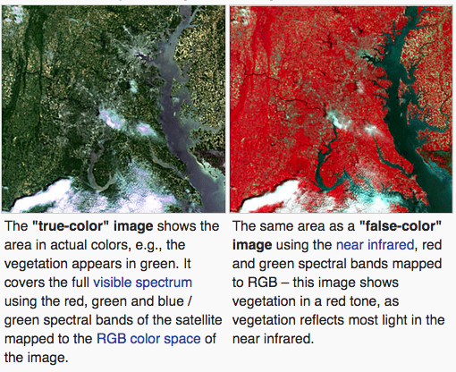

Slide 8
Types of color renderings..
Pseudo color image
is derived from a grayscale image by mapping each intensity value to a color according to a table or function. Pseudo color is typically used when a single channel of data is available (e.g. temperature, elevation, soil composition, tissue type, and so on), in contrast to false color which is commonly used to display three channels of data.
A typical example for the use of pseudo color is thermography ("thermal imaging"), where infrared cameras feature only one spectral band and show their grayscale images in pseudo color.

Slide 9
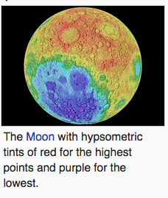

Slide 10
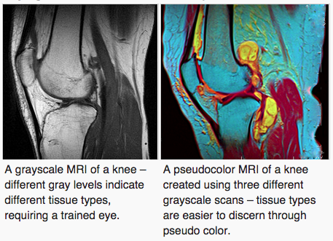

Slide 11
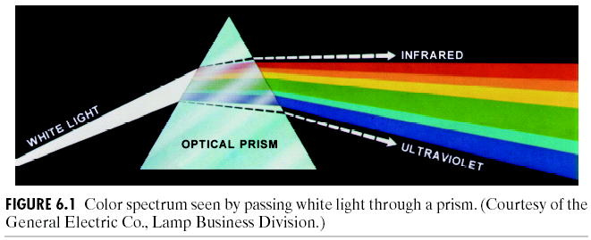
Color Spectrum white light with a prism (1666, Newton)

Slide 12
How do we perceive color ?
we see an object because light falls on the object or the object is illuminated by certain source of light, the light gets reflected from the object, it reaches our eye, then only we can see the object.
Similarly, we can perceive the color depending upon the nature of the light which is reflected by the object surface.
The nature of the light through the spectrum in the visible range gives different colors so we are able to observe it.

Slide 13
The actual color perceived by a human of an object depends on both the color of the illumination and the reflectivity of the object, as well as the sensitivity of human perception.
Objects appear to be different colors because they absorb and reflect different colors of light. A blue object, for example, reflects blue light while absorbing other colors.
Grey objects or grey images reflect and absorb all frequencies of light about equally, so they do not appear colored.

Slide 14
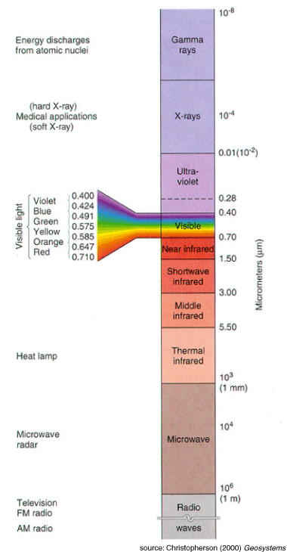
Physical Background
Visible light: a narrow band of electromagnetic radiation → 380nm (blue) − 780nm (red)
Wavelength: Each physically distinct colour corresponds to at least one wavelength in this band.
Pure Colours: Pure or monochromatic colours do not exist in nature.

Slide 15
Problems with Processing Colour Images
When processing colour images, the following problem (amongst others) have to be dealt with:
The colours recorded by a camera are heavily dependent on the lighting conditions.

Slide 16
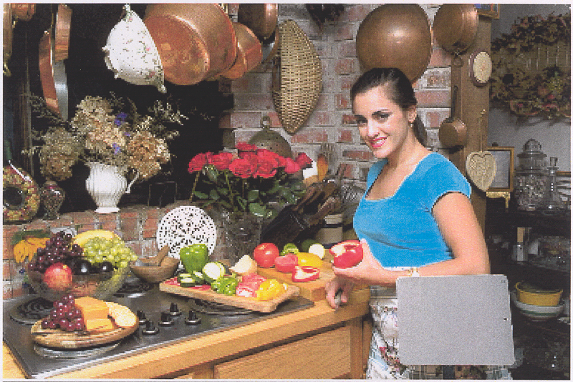
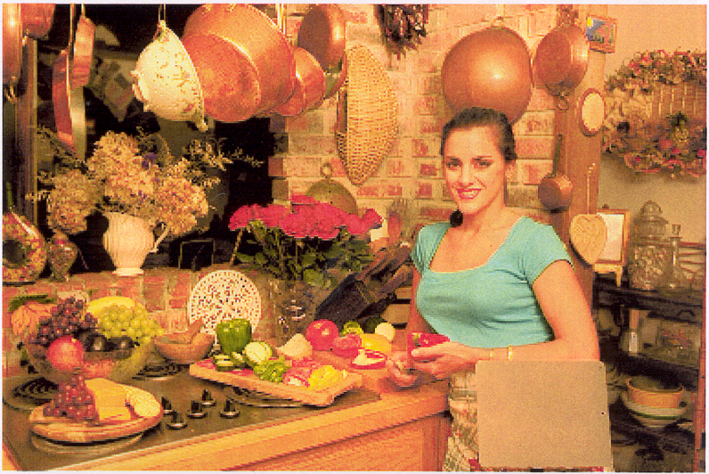
Lighting conditions
The lighting conditions of the scene have a large effect on the colours recorded.
Image taken lit by a flash.
Image taken lit by a tungsten lamp.

Slide 17
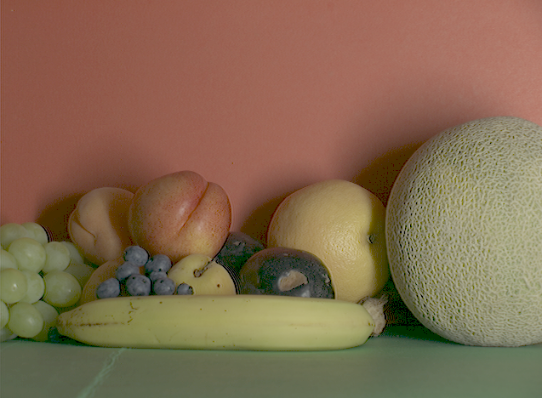
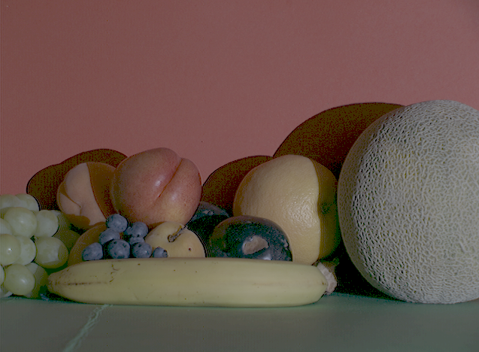
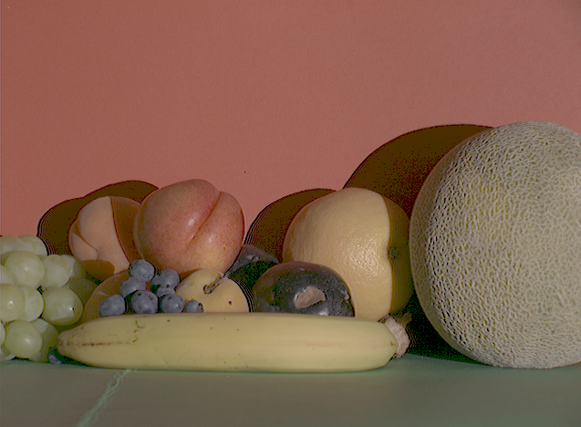
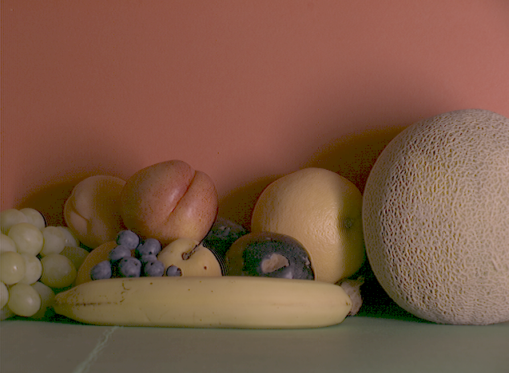
The following four images of the same scene were acquired under different lighting conditions:

Slide 18
Quality of light
Radiance
Radiance is the total amount of energy which comes out of a light source and is measured in the form of in units of watts.
Luminance
luminance, it is the amount of energy that is perceived by an observer.
Luminance measured in units of lumens
Brightness.
it is actually a subjective measure and it is practically not possible to measure the amount of brightness.

Slide 19
Dealing with Lighting Changes
Knowing just the RGB values is not enough to know everything about the image.
The R, G and B primaries used by different devices are usually different.
For scientific work, the camera and lighting should be calibrated.
For multimedia applications, this is more difficult to organise:
Algorithms exist for estimating the illumination colour.

Slide 20
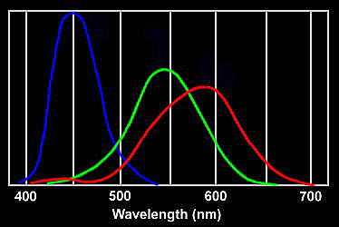
primary colors
Color is sensed by the eye using three kinds of cones cells, each sensitive primarily to red, green or blue, though there is significant overlap.
We refer to red, green and blue as the primary colors, and denote to set as RGB.
International Commission
on Illumination (CIE)
red = 700nm
green = 546.1nm
blue = 435.8nm

Slide 21
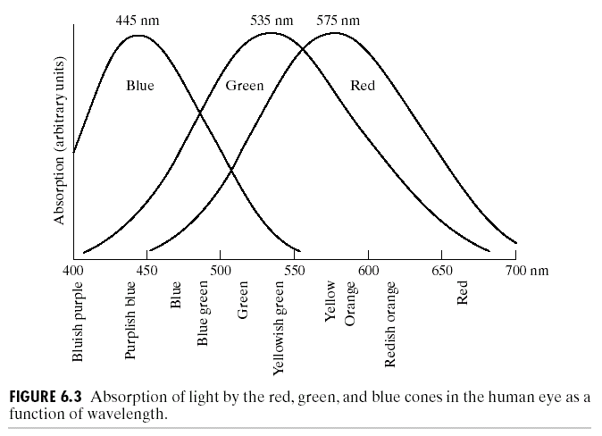

Slide 22
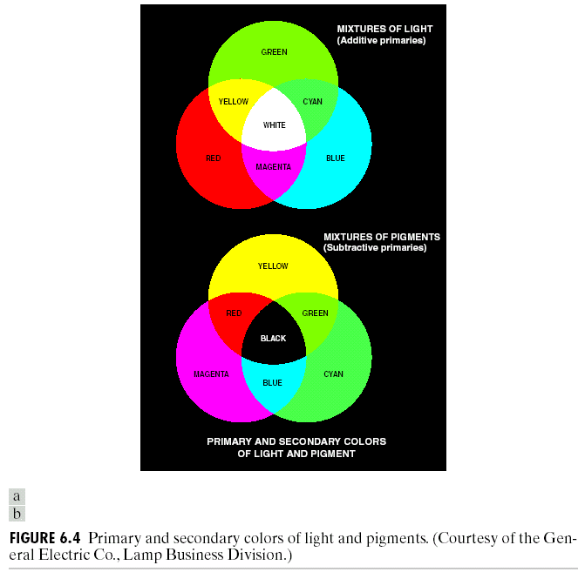

Color Fundamentals
Secondary colors: magenta (red + blue), cyan (green + blue), and yellow (red + green)
when it comes to the pigments the primary color of a pigment is defined as an wavelength which is absorbed by the pigment and it reflects the other 2 wavelengths. So, the primary color of light should be the opposite of the primary color of a pigment.

Slide 23
But when we perceive a color, we do not really think about how much of red component, blue component and green component that particular color has.
But the way we try to distinguish the color is based on the characteristics which are called brightness, hue and saturation.

Slide 24
Brightness
Brightness achromatic notion of intensity.
Hue
It represents the dominant wavelength in a mixture of colors. So, when you look at a secondary color which is a mixture of different primary colors, there will be one wavelength which is a dominant one, dominant wavelength and the overall sensation of that particular secondary color will be determined by the dominant wavelength.
Saturation
Whenever we talk about a particular color red, there may be various shades of red. So, the saturation indicates the purity of that particular color or in other words, what is the amount of light which has been mixed to that particular color to make it a diluted one.

Slide 25
we normally perceive the color in the form of hue, saturation and brightness
In hardware, it is represented as red green and blue

Slide 26





Chromaticity Diagram
The amounts of red, green, and blue needed to form any particular color are called tristimulus values (X, Y and Z). These represent three dimensional coordinates of any perceived color.
The tristimulus values can be normalized to give chromatic coefficients, x (red), y (green) and z (blue).
Note that because of normalization, x+y+z = 1.

Slide 27
If the wavelength of the pure colors are plotted in these coordinates, and the mixtures of these wavelengths are plotted inside the pure colors, the result is known as the CIE chromaticity diagram.
In the chromaticity diagram, white light is defined as the mixture of equal amounts of all wavelengths of visible light.

Slide 28
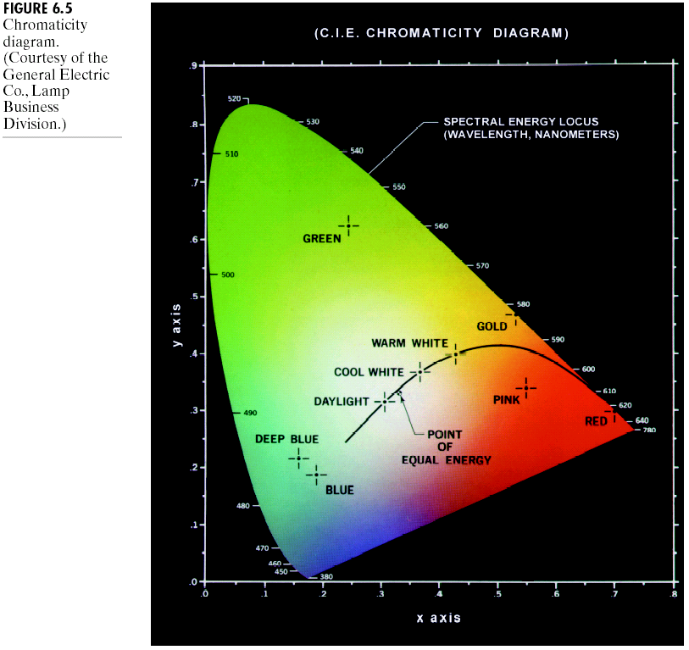

Chromaticity Diagram
Since x, y and z are not independent, only x and y are enough to specify a color.
And we can get by
z= 1-(x+y)
As we know x+y+z = 1.

Slide 29




Chromaticity Diagram
Color mixing

Slide 30


Chromaticity Diagram
mixing white light to saturated color

Slide 31
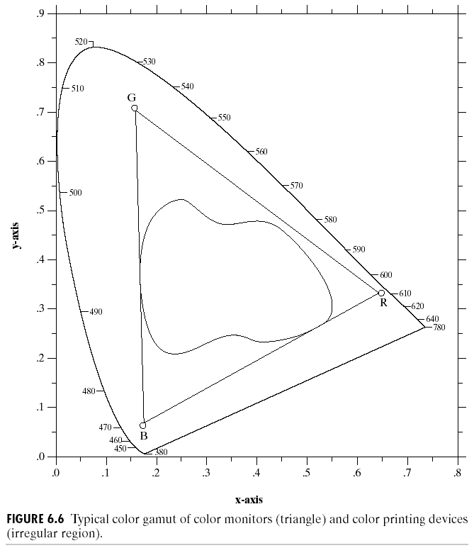
Color Fundamentals

Slide 32
Color model
RGB model or red, green blue model
image displays like monitor
CMY model: cyan, magenta and yellow
useful for image printer
CMYK model: cyan, yellow magenta and black.
useful for image printers
HSI color model: hue, saturation and intensity or brightness
application oriented or also, it is perception oriented. That is how we perceive a particular color

Slide 33
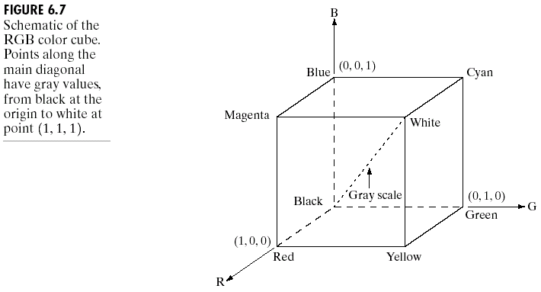


Color Models -- RGB Model
RGB color model is based on Cartesian coordinate system

Slide 34
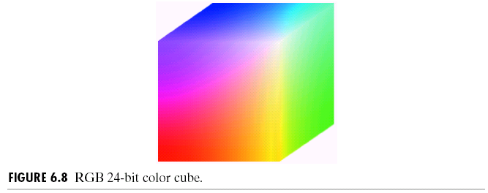


Color Models -- RGB Model
True color supports 24-bit for three RGB colors. It provides a method of representing and storing graphical-image information (especially in computer processing) in an RGB color space such that a very large number of colors, shades, and hues can be displayed in an image, such as in high-quality photographic images or complex graphics.
Usually, true color is defined to mean 256 shades of red, green, and blue, for a total of 224 or 16,777,216 color variations. The human eye can discriminate up to ten million colors.

Slide 35
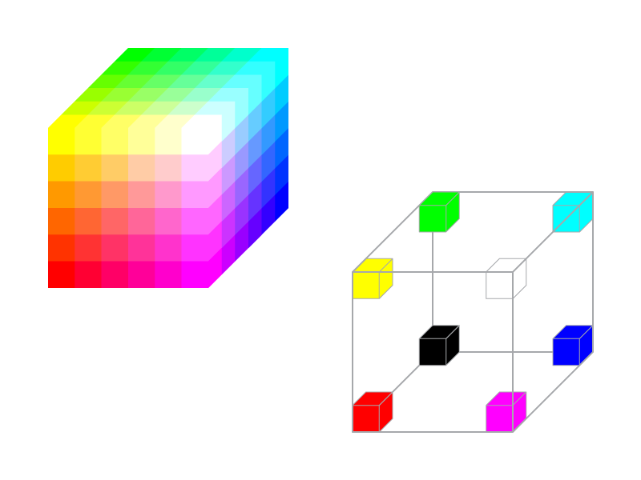

Safe RGB Color Cube

Slide 36
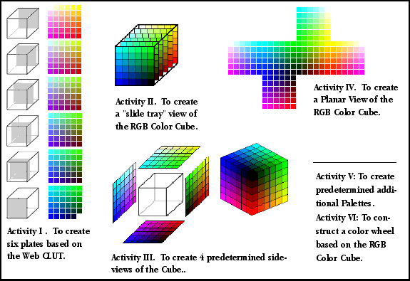


Slide 37
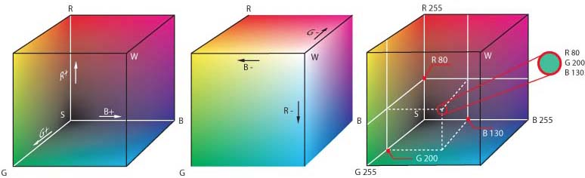

Slide 38
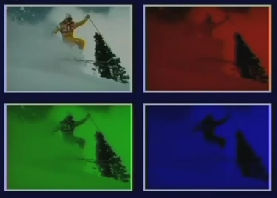

Slide 39
Summery of the lecture
Color image processing
Primary and secondary colors
Color characteristics
Chromaticity diagram and its use
Color models
RGB color model

Slide 40
References
Prof .P. K. Biswas Department of Electronics and Electrical Communication Engineering Indian Institute of Technology, Kharagpur
Gonzalez R. C. & Woods R.E. (2008). Digital Image Processing. Prentice Hall.
Forsyth, D. A. & Ponce, J. (2011).Computer Vision: A Modern Approach. Pearson Education.

